Slide 1
Schedule
8:30 to 9:00: Introduction
9:00 to 10:00: Offline uses of attributes
10:00 to 10:15: Q&A
10:15 to 10:30: Break
10:30 to 11:00: Offline uses of attributes (cont.)
11:00 to 11:45: Online uses of attributes
11:45 to noon: Q&A
Noon to 1:30: Lunch
1:30 to 3:25: Attributes as features
3:25 to 4:00: Break
4:00 to 4:45: Describing images
4:45 to 5:30: Discovering a vocabulary of attributes
5:30 to 6:00: Pointers to resources and concluding remarks
All material will be posted online
Slide credit: Devi Parikh

Slide 2
Attributes in “online” tasks
Image search
Human-in-the-loop recognition
Slide credit: Kristen Grauman

Slide 3
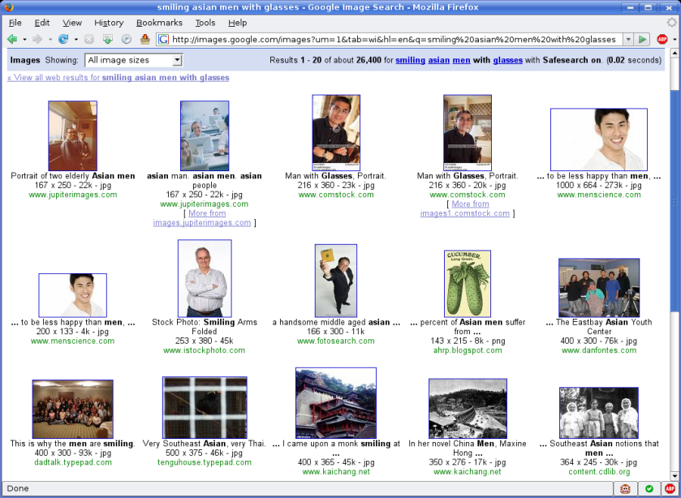
Image search
Meta-data commonly used, but insufficient
Keyword query: “smiling asian men with glasses”
Slide credit: Kristen Grauman

Slide 4
Why are attributes relevant to image search?
Human understandable
Support familiar keyword-based queries
Composable for different specificities
Efficiently divide space of images
Slide credit: Kristen Grauman

Slide 5
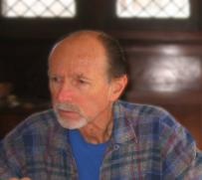
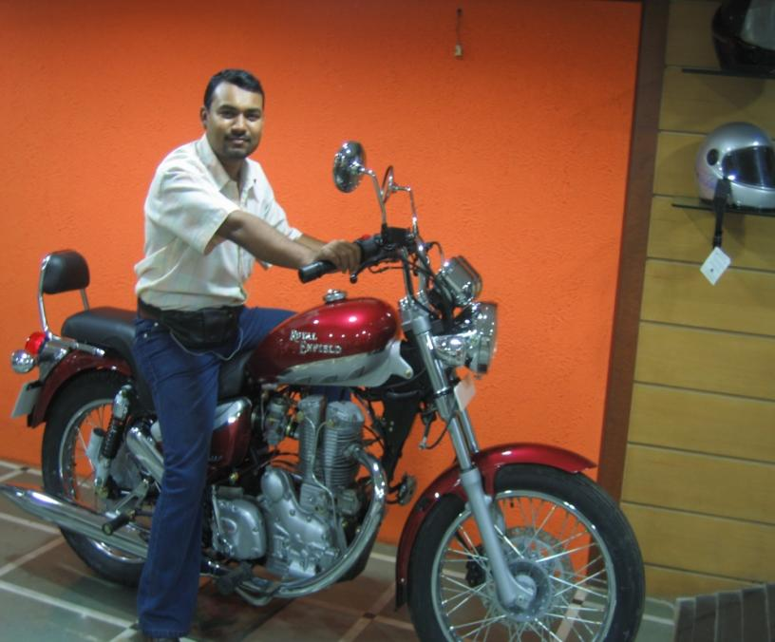

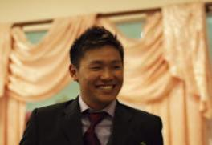
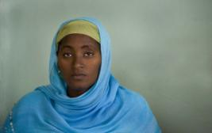

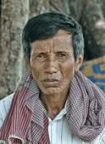
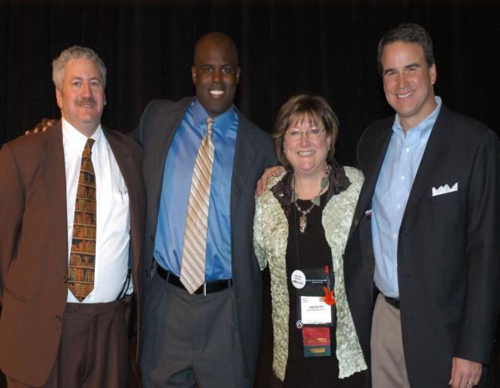
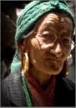
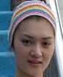
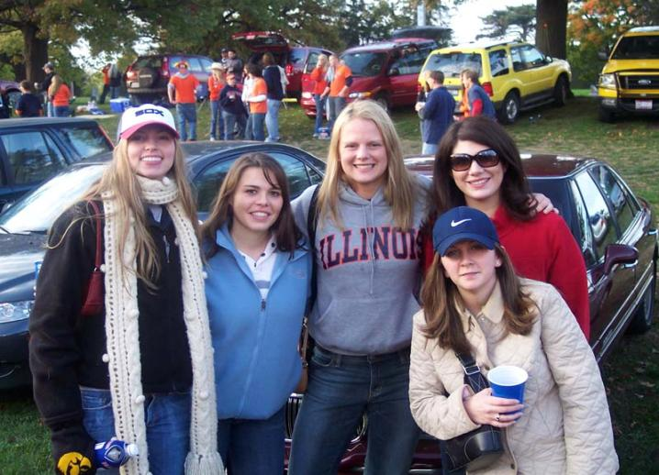
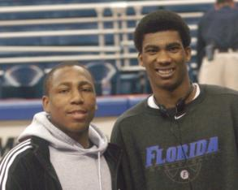
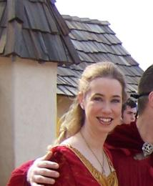
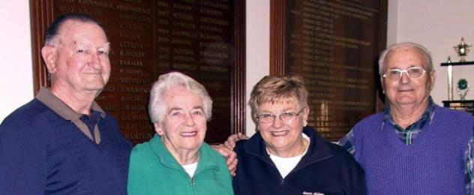


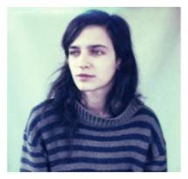


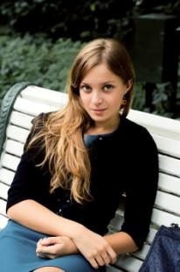
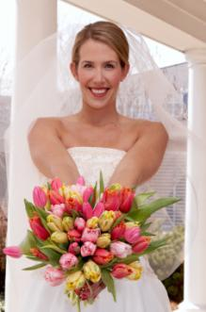
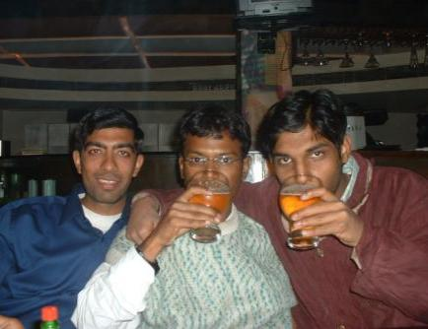
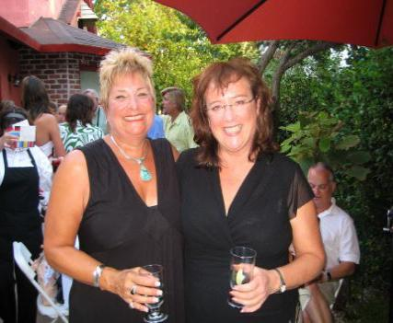
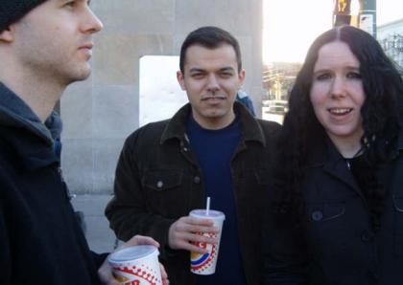

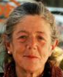
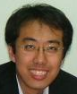

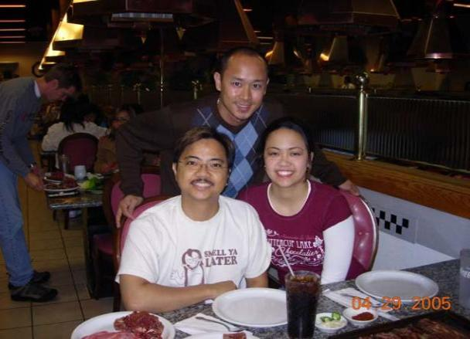
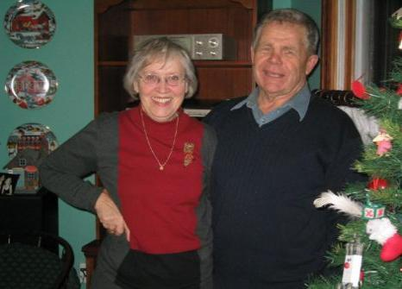


Attributes are composable
Caucasian
Teeth showing
Outside
Tilted head
Attributes can be combined for different specificities
Slide credit: Neeraj Kumar

Slide 6
Attributes efficiently divide the space of images
Female
Caucasian
Eyeglasses
Older
k attributes can distinguish 2^{k} categories
Slide credit: Neeraj Kumar

Slide 7
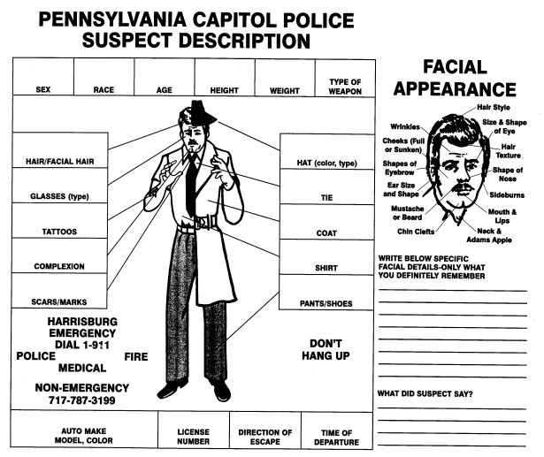
Search applications: finding people
Slide credit: Rogerio Feris

Slide 8
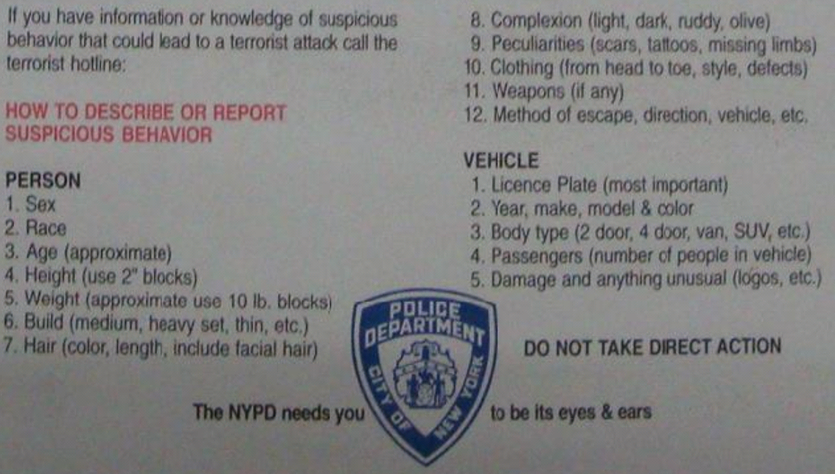

Search applications: finding people
Slide credit: Rogerio Feris

Slide 9
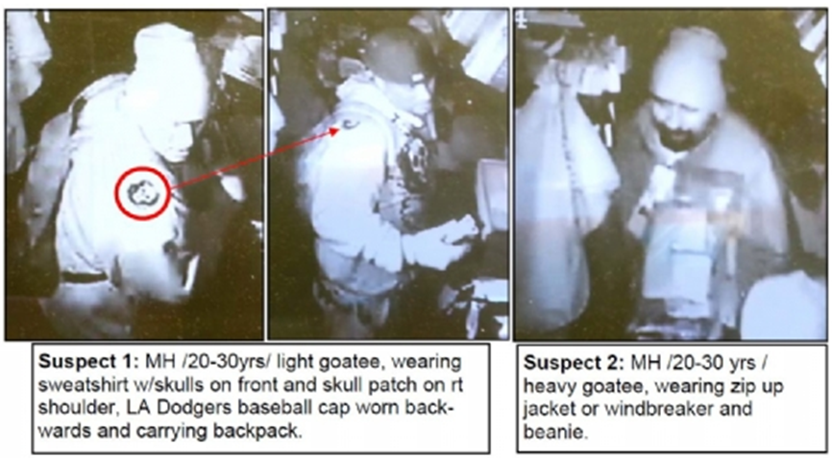
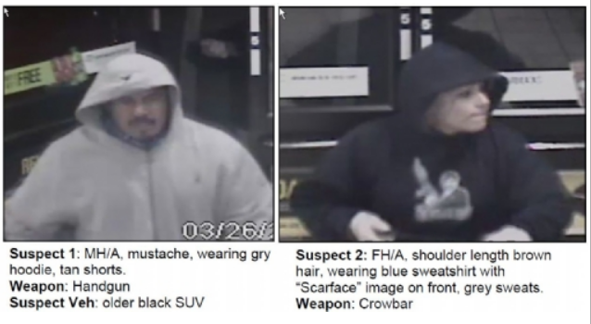
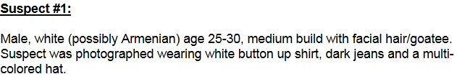

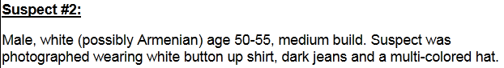

Search applications: finding people
Search surveillance feeds for suspects
http://lacrimestoppers.com/wanteds.aspx
Slide credit: Rogerio Feris

Slide 10
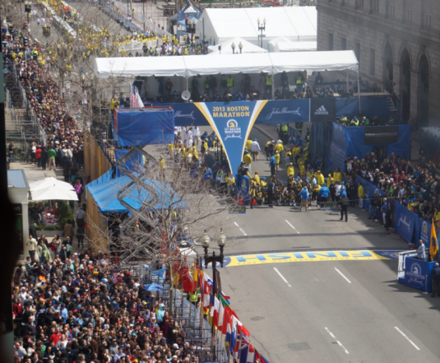
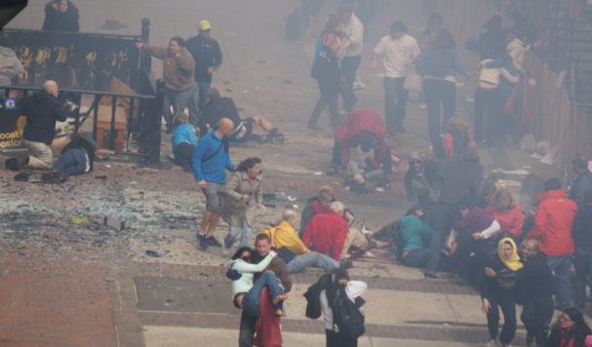
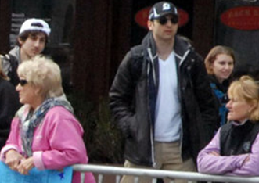
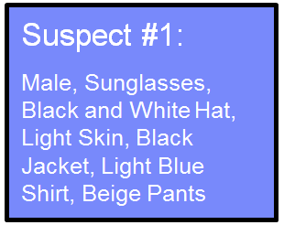
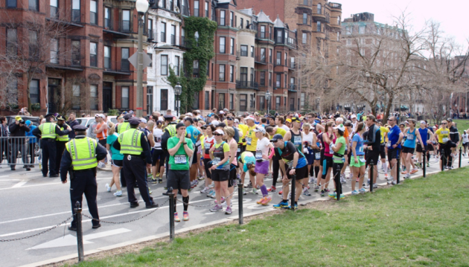
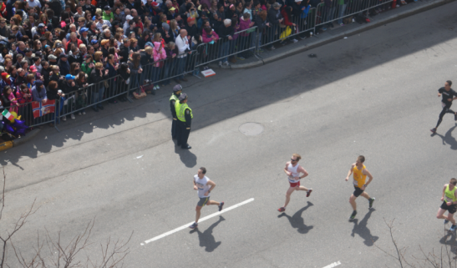
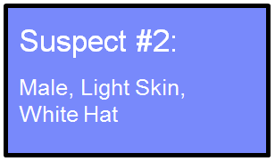
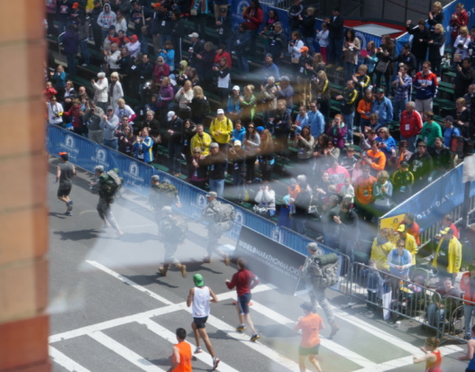
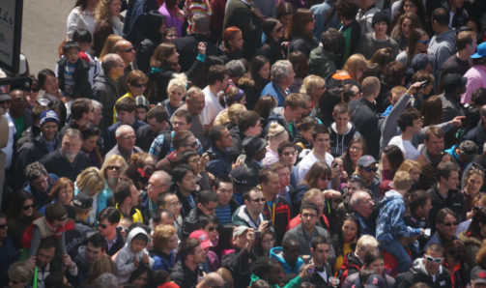
Search applications: finding people
Search images from ad hoc cameras using semantic descriptions
Adapted from: Rogerio Feris

Slide 11
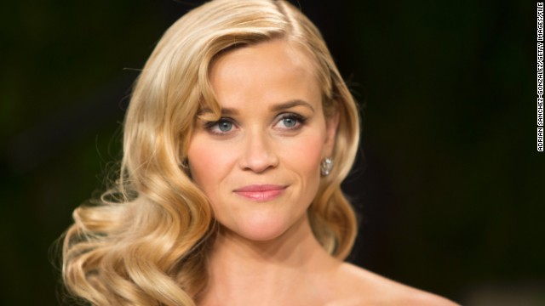
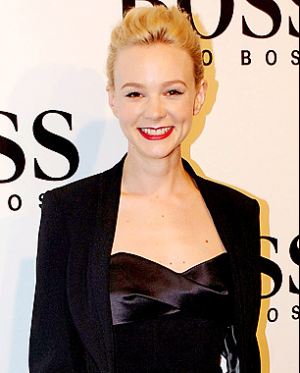
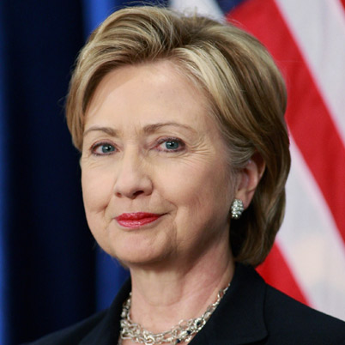
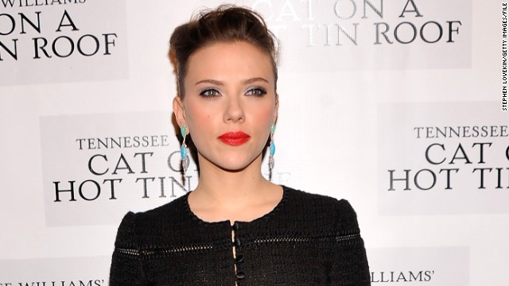
Search applications: finding people
What actress looks like a young Hillary Clinton?
Similar to, but younger than…
?
Slide credit: Kristen Grauman

Slide 12
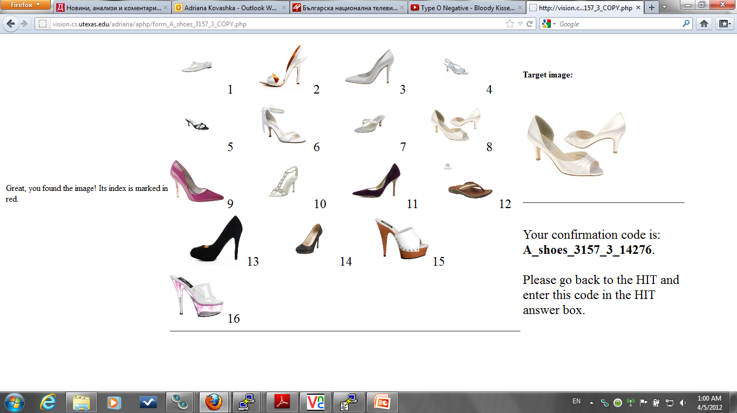
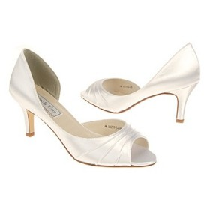
Search applications: products
Query: “I want a bright, open shoe that is short
on the leg.”
Slide credit: Kristen Grauman

Slide 13

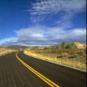

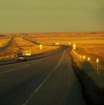
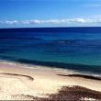
Search applications: graphic design
Query: “I want an outdoor scene that looks uncrowded and calm
Slide credit: Kristen Grauman

Slide 14
Attributes in “online” tasks
Image search
Human-in-the-loop recognition
Slide credit: Kristen Grauman

Slide 15
Attributes in “online” tasks
Image search
Attributes as keyword queries
Multi-attribute queries
Attributes for relevance feedback
Human-in-the-loop recognition
Slide credit: Kristen Grauman

Slide 16
Face Search with Attributes Neeraj Kumar et al.
FaceTracer: A Search Engine for Large Collections of Images with Faces, Neeraj Kumar, Peter N. Belhumeur, Shree K. Nayar, ECCV 2008.
Describable Visual Attributes for Face Verification and Image Search, Neeraj Kumar, Alexander C. Berg, Peter N. Belhumeur, Shree K. Nayar, PAMI 2011.

Slide 17
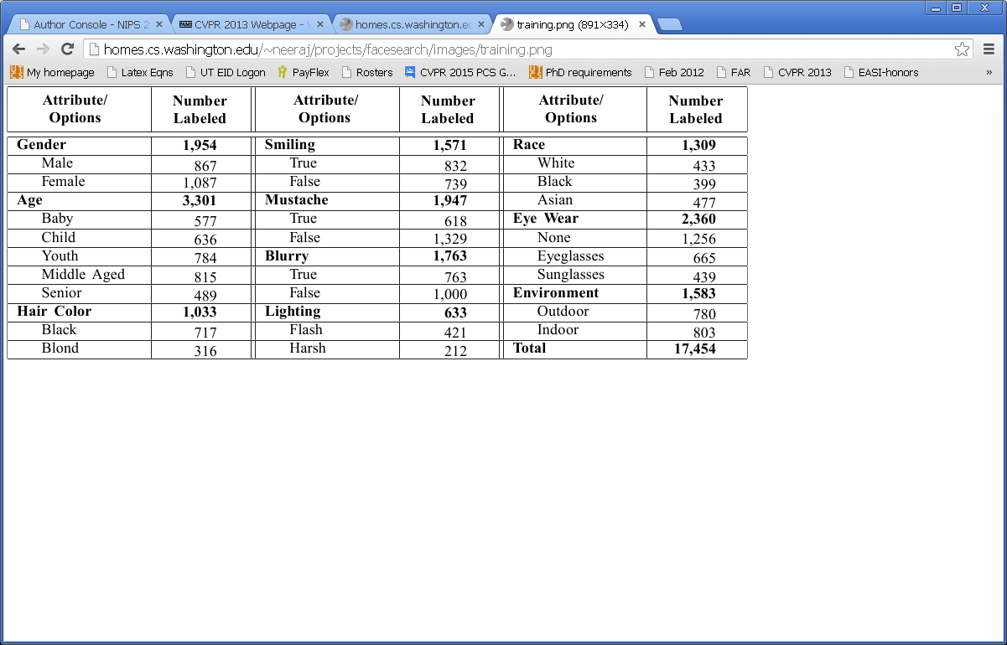
Facial Attributes
Various properties of interest to search
Many are spatially localized within face

Slide 18



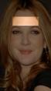




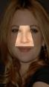





14 Regions x 20 Feature Types = 280 Feature Choices
Learning a Face Attribute Classifier
Face Regions
Feature Types
RGB
Not Normalized
Raw Pixels
Gradient Magnitude
Not Normalized
Raw Pixels
RGB
Mean-Normalized
Raw Pixels
Gradient Magnitude
Mean Normalized
Raw Pixels
RGB
Energy-Normalized
Raw Pixels
Gradient Magnitude
Not Normalized
Histogram
top hair
small hair
right hair
forehead
eyebrows
RGB
Not Normalized
Mean and Variance
Gradient Orientation
Not Normalized
Raw Pixels
Intensity
Not Normalized
Raw Pixels
Gradient Orientation
Not Normalized
Histogram
Intensity
Not Normalized
Histogram
HSV
Not Normalized
Raw Pixels
eyes
face
side hair
nose
cheeks
Intensity
Energy-Normalized
Histogram
HSV
Mean-Normalized
Raw Pixels
Intensity
Mean-Normalized
Histogram
HSV
Energy-Normalized
Raw Pixels
Intensity
Energy-Normalized
Raw Pixels
HSV
Not Normalized
Histogram
Intensity
Mean-Normalized
Raw Pixels
HSV
Not Normalized
Mean and Variance
mustache
mouth
chin
neck
Slide credit: Neeraj Kumar

Slide 19








Learning a Face Attribute Classifier
Training
images
Low-level
features
Feature
selection
RGB
HoG
RGB, Nose
HSV
HoG, Eyes
…
Males
HSV, Hair
RGB
Edges, Mouth
HoG
…
HSV
…
Females
Slide credit: Neeraj Kumar

Slide 20
Learning a Face Attribute Classifier
Training
images
Low-level
features
Feature
selection
Train
classifier
RGB
HoG
RGB, Nose
HSV
HoG, Eyes
…
HSV, Hair
Gender
classifier
Males
RGB
Edges, Mouth
HoG
…
HSV
…
Females
Slide credit: Neeraj Kumar

Slide 21
Attribute Classifier Accuracies
Binary facial attributes in Columbia Face Database
Typically 80%-90% accuracy
gender | 85.78 | hair color: black | 90.82 | flushed face | 88.85
age: young | 87.72 | hair color: blond | 88.39 | chubby | 81.16
age: middle aged | 84.93 | hair color: brown | 74.88 | forehead: fully visible | 89.31
age: senior | 92.04 | hair color: gray | 89.86 | forehead: partially visible | 76.96
race: Asian | 92.32 | hair color: bald | 90.39 | forehead: obstructed | 81.24
race: white | 91.50 | bangs | 91.54 | blurry | 93.42
race: black | 88.65 | receding hairline | 86.83 | color / b&w | 97.88
race: indian | 86.47 | attractive woman | 82.56 | photo type | 71.89
face_shape: oval | 73.30 | attractive man | 74.16 | lighting: soft | 68.46
face_shape: square | 78.60 | eye wear: eyeglasses | 93.32 | lighting: harsh | 77.01
face_shape: round | 75.47 | eye wear: sunglasses | 96.50 | lighting: flash | 73.36
hair_texture: curly | 70.07 | eye wear: none | 93.32 | environment | 85.27
hair_texture: wavy | 66.58 | wearing hat | 89.12 | expression: smiling | 95.91
hair texture: straight | 78.38 | pale skin | 89.36 | expression: frowning | 95.28
heavy makeup | 89.01 | shiny skin | 84.25
Slide credit: Neeraj Kumar

Slide 22

Importance of localized attributes

Slide 23
FaceTracer: Searching for faces with attributes
Offline:
Apply attribute classifiers to database images
Map classifier outputs to probabilities
Online:
Convey available attribute names to user
Given query attributes, rank database images by confidence (e.g., product of probabilities)

Slide 24
Google: “smiling asian men with glasses” July 2008
Slide credit: Neeraj Kumar

Slide 25

FaceTracer: “smiling asian men with glasses”
Slide credit: Neeraj Kumar

Slide 26

FaceTracer: “older men with mustaches”
Slide credit: Neeraj Kumar

Slide 27




Attribute-based person search in video
Vaquero, Feris, Tran, Brown, Hampapur and Turk.
Attribute-Based People Search in Surveillance Environments. WACV 2009.
Video from camera
Analytics Engine
Database Backend
Background Subtraction
Face Detection & Tracking
Attribute Detectors
Search Interface
Result – thumbnails of clips matching the query
Suspect description form (query specification)
Slide credit: Rogerio Feris

Slide 28

Video Demo: Attribute-based People Search

Slide 29



Example query: Boston bombing scenario
Rogerio Feris et al.
1071 detected faces from 50 high-res Boston images (all from Flickr)
Ability to spot a person with e.g., a white hat in a crowded scene
Suspect #1 found in 4 images in top 8 results
Suspect #2 found in 3 images in top page
Slide credit: Rogerio Feris

Slide 30
Attributes in “online” tasks
Image search
Attributes as keyword queries
Multi-attribute queries
Attributes for relevance feedback
Human-in-the-loop recognition
Slide credit: Kristen Grauman

Slide 31
Issues in multi-attribute queries
Calibration of attribute classifiers
Distances in raw multi-dimensional “attribute space” need not capture perceptual similarity
Fusing the specified attributes in query
How to rank database images based on satisfying all attributes?
Providing context for the query
Pairs of attributes are often correlated
Slide credit: Kristen Grauman

Slide 32

Calibration issue
Multi-Attribute Spaces: Calibration for Attribute Fusion and Similarity Search,
Walter J. Scheirer, Neeraj Kumar, Peter N. Belhumeur, Terrance E. Boult, CVPR 2012
Slide credit: Walter Scheirer

Slide 33

Calibration issue
Multi-Attribute Spaces: Calibration for Attribute Fusion and Similarity Search,
Walter J. Scheirer, Neeraj Kumar, Peter N. Belhumeur, Terrance E. Boult, CVPR 2012
Slide credit: Walter Scheirer

Slide 34

Calibration issue
Scheirer et al., CVPR 2012
Intuition: values close to decision boundary most informative
Multi-Attribute Spaces: Calibration for Attribute Fusion and Similarity Search, Scheirer et al., CVPR 2012
Slide credit: Walter Scheirer

Slide 35

Fusing multi-attribute queries
How to rank database images based on how well they satisfy all attributes?
-- Multiply attribute probabilities, but
Attributes often correlated
May be no database image satisfying all attributes

Slide 36

Fusing multi-attribute queries
Model Correlations between Attributes
Explicitly utilize information from non-query attributes
Slide credit: Rogerio Feris
B. Siddiquie, R. Feris, and L. Davis. Image Ranking and Retrieval based on Multi-Attribute Queries. CVPR 2011.

Slide 37























Fusing multi-attribute queries
MARR
Short Hair
Lipstick
No Eyewear
rankBoost
MARR
Black
Goatee
Youth
rankBoost
MARR
Asian
Eyeglasses
rankBoost
Slide credit: Rogerio Feris
B. Siddiquie, R. Feris, and L. Davis. Image Ranking and Retrieval based on Multi-Attribute Queries. CVPR 2011.

Slide 38
Attributes in “online” tasks
Image search
Attributes as keyword queries
Multi-attribute queries
Attributes for relevance feedback
Human-in-the-loop recognition
Slide credit: Kristen Grauman

Slide 39


Problem with one-shot visual search
Keywords (even attributes) can be insufficient to capture query in one shot.
Complete “indicator vector” over attributes need not adequately capture envisioned target.
Slide credit: Kristen Grauman

Slide 40








Interactive visual search
Feedback
Results
Iteratively refine the set of retrieved images based on user feedback on results so far
Potential to communicate more precisely the desired visual content
Slide credit: Adriana Kovashka

Slide 41







Limitations of traditional interactive methods
color
0.2
…
…
texture
0.2
shape
0.6
Tuning system parameters difficult for user
[Flickner et al. 1995, Ma & Manjunath 1997, Iqbal & Aggarwal 2002]
Slide credit: Adriana Kovashka

Slide 42












Limitations of traditional interactive methods
“white
high
heels”
relevant
irrelevant
relevant
irrelevant
Tuning system parameters difficult for user
[Flickner et al. 1995, Ma & Manjunath 1997, Iqbal & Aggarwal 2002]
Traditional binary feedback imprecise
[Rui et al. 1998, Zhou et al. 2003, …]
Slide credit: Adriana Kovashka

Slide 43










WhittleSearch: relative attribute feedback
Kovashka et al., CVPR 2012
Query: “white high-heeled shoes”
Initial top
search results
…
Feedback:
“more formal
than these”
Feedback:
“shinier
than these”
…
Refined top
search results
Whittle away irrelevant images via precise attribute feedback
Slide credit: Kristen Grauman
WhittleSearch: Image Search with Relative Attribute Feedback. A. Kovashka, D. Parikh, and K. Grauman. CVPR 2012

Slide 44




















Learning relative attributes
We want to learn a spectrum (ranking model) for an attribute, e.g. “brightness”.
Supervision consists of:
Ordered pairs
Similar pairs
Parikh and Grauman, ICCV 2011
Slide credit: Adriana Kovashka

Slide 45


Learning relative attributes
Learn a ranking function
Image features
Learned parameters
that best satisfies the constraints:
Parikh and Grauman, ICCV 2011
Slide credit: Devi Parikh

Slide 46


Learning relative attributes
Max-margin learning to rank formulation
Rank margin
w_{m}
Image Relative attribute score
Parikh and Grauman, ICCV 2011; Joachims, KDD 2002
Slide credit: Devi Parikh

Slide 47



























Relating images
bright
formal
natural
Rank images according to attribute presence
Slide credit: Adriana Kovashka

Slide 48





WhittleSearch with relative attribute feedback
natural
scores = scores + 1
“I want something
less natural than this.”
scores = scores + 0
Offline:
Learn a spectrum for each attribute
During search:
User selects some reference images and marks how they differ from the desired target
Update the scores for each database image
Kovashka et al., CVPR 2012
Slide credit: Adriana Kovashka

Slide 49





WhittleSearch with relative attribute feedback
“I want something more natural than this.”
perspective
score = 0
“I want something less natural than this.”
score = 1
score = 2
score = 1
score = 2
score = 3
score = 1
score = 1
score = 2
natural
score = 0
score = 1
score = 1
score = 1
score = 2
score = 2
“I want something with more perspective than this.”
score = 1
score = 1
score = 1
Kovashka et al., CVPR 2012
Slide credit: Adriana Kovashka

Slide 50









































Datasets
Shoes:
14,658 shoe images;
10 attributes:
“pointy”, “bright”, “high-heeled”, “feminine” etc.
OSR:
2,688 scene images;
6 attributes:
“natural”, “perspective”, “open-air”, “close-depth” etc.
PubFig:
772 face images;
11 attributes:
“masculine”, “young”, “smiling”, “round-face”, etc.
Slide credit: Adriana Kovashka

Slide 51





Experimental setup
Give the user the target image to look for
Pair each target image with 16 reference images
Get judgments on pairs from users on MTurk
pointy
open
bright
ornamented
shiny
high-heeled
long on the leg
formal
sporty
feminine
Is than ?
similar to
or
dissimilar from
more
or
less
Is ?
Binary feedback baseline
Relative attribute feedback
Slide credit: Adriana Kovashka

Slide 52



WhittleSearch Results
vs.
We more rapidly converge on the envisioned visual content.
Richer feedback → faster gains per unit of user effort.
[Kovashka et al., CVPR 2012]
Slide credit: Kristen Grauman

Slide 53








Example WhittleSearch
Query: “I want a bright, open shoe that is short
on the leg.”
Selected feedback
More open than
Less high at the heel than
Round 1
More bright in color than
Less ornaments than
Round 2
Round 3
More formal than
More bright in color than
Higher at the heel than
Match
More open than
[Kovashka et al., CVPR 2012]
Slide credit: Adriana Kovashka

Slide 54

Failure case (?)
Is the user searching for a specific person, or a person meeting the description?
Slide credit: Adriana Kovashka

Slide 55






Hybrid relevance feedback
Feedback:
“more shiny
than these”
“shininess”
“similar
to these”
Image database
More relevant
Less relevant
“dissimilar
from these”
Relevance constraints
We integrate relative attribute and binary feedback by learning a relevance ranking function.
[Kovashka et al., CVPR 2012]
Slide credit: Kristen Grauman

Slide 56






Example hybrid WhittleSearch
Selected feedback
Query: “I want a non-open shoe that is long on the leg and covered in ornaments.”
Dissimilar from
Similar to
Round 1
More bright than
Less open than
Round 2
Match
[Kovashka et al., CVPR 2012]
Slide credit: Adriana Kovashka

Slide 57

Come see our WhittleSearch demo!
Thursday, 10:15-12:00 -- Exhibit Halls A-A1
Naman Agrawal, Arijit Biswas, Adriana Kovashka, Kristen Grauman, Devi Parikh

Slide 58
Attributes in “online” tasks
Image search
Attributes as keyword queries
Multi-attribute queries
Relative attributes for relevance feedback
Human-in-the-loop recognition
Slide credit: Kristen Grauman

Slide 59

What Plant Species is This?
Slide credit: Neeraj Kumar

Slide 60



Let’s Use a Field Guide
Slide credit: Neeraj Kumar

Slide 61





Types of Recognition
Basic-Level
Parts & Attributes
Subordinate
Airplane? Chair? Bottle? …
Yellow Belly? Blue Belly?…
American Goldfinch? Indigo Bunting?…
Humans
Hard, limited memory & experiences
Easy
Easy
Computers
Hard, but can store large knowledge bases
Some Success
Some Success
Slide credit: Steve Branson

Slide 62
Recognition With Humans in the Loop
Wah et al., Multi-class Recognition and Part Localization with Humans in the Loop, ICCV 2011
Computer Vision
Cone-shaped Beak? yes
Computer Vision
American Goldfinch? yes
Computers: reduce number of required questions
Humans: drive up accuracy of vision algorithms
Slide credit: Steve Branson

Slide 63

Example Questions: Localize
Wah et al., Multi-class Recognition and Part Localization with Humans in the Loop, ICCV 2011
Slide credit: Steve Branson

Slide 64

Example Questions: Name attributes
Wah et al., ICCV 2011
Slide credit: Steve Branson

Slide 65

Basic Algorithm
Computer Vision
Max Expected Information Gain
Input Image ( )
Question 1:
A: (x,y)
Click on the belly
Max Expected Information Gain
Question 2:
A: YES
Is the bill hooked?
…
Wah et al., ICCV 2011
Slide credit: Steve Branson

Slide 66
Basic Algorithm
Select the next question that maximizes expected information gain:
Involves estimating probabilities of the form:
Object Class
Image
Sequence of user responses
Wah et al., ICCV 2011
Slide credit: Steve Branson

Slide 67
Basic Algorithm
Integrate over all possible locations of the parts:
Model of user responses
Localized attribute estimator
(DAP)
Part Localization
Wah et al., ICCV 2011
Slide credit: Steve Branson

Slide 68

Modeling User Responses: Attribute Questions
Assume:
Estimate using Mechanical Turk
What is the color of the belly?
Definitely
Probably
Guessing
grey
red
black
white
brown
blue
grey
red
black
white
brown
grey
red
black
brown
blue
white
blue
Pine Grosbeak
Wah et al., ICCV 2011
Slide credit: Steve Branson

Slide 69
Modeling User Responses: Click Questions
Assume:
Estimate using Mechanical Turk
Click on the breast
Wah et al., ICCV 2011
Slide credit: Steve Branson

Slide 70



Modeling Part Location Probabilities
Sliding window part detectors w/ HOG features
Mixture of tree-structured deformable part models
Algorithm to efficiently refine all part predictions after a user answers a part click question
Wah et al., ICCV 2011
Slide credit: Steve Branson

Slide 71




Modeling Localized Class Probabilities based on attributes
Sample part locations according to detection probability
For a candidate set of part locations, extract localized features and train a multiclass classifier to estimate
Color Histograms
SIFT
Wah et al., ICCV 2011
Slide credit: Steve Branson

Slide 72







CUB-200-2011 Dataset
Black-footed Albatross
Groove-Billed Ani
Parakeet Auklet
Field Sparrow
Vesper Sparrow
11,877 images, 200 bird species
13 part locations
288 binary attributes
Wah et al., ICCV 2011
Slide credit: Steve Branson

Slide 73

Results: Without Computer Vision
Perfect Users, Field Guide Attributes
100% accuracy in 8≈log₂(200) questions if users agree with field guides…
Real Users, Probabilistic User Model
Tolerate ambiguous responses, user error
Real Users, Field Guide Attributes
MTurkers don’t always agree with field guides…
Branson et al., ECCV 2010
Slide credit: Steve Branson

Slide 74

Results: With Computer Vision
Incorporating computer vision reduces ave time to identify true species from 109 sec to 37 sec
Intelligently selecting questions reduces ave time from 69 sec to 37 sec
Base Computer Vision performance (30%)
Wah et al., ICCV 2011
Slide credit: Steve Branson

Slide 75

Demo
Wah, Branson, Perona, Belongie, Multi-class Recognition and Part Localization with Humans in the Loop, ICCV 2011
Slide credit: Steve Branson

Slide 76
Summary: Attributes for online tasks
Attributes give human user way to
Communicate search queries
Give feedback in interactive search
Assist in interactive recognition
Slide credit: Kristen Grauman

Slide 77
Ongoing challenges
Accuracy of attribute models crucial to success
Human perception of attributes can vary
When is the attribute vocabulary expressive enough?
If large attribute vocabulary is available, how to convey it to the search user?
Practical issues in calibration and fusion
Localized vs. global properties
Slide credit: Kristen Grauman

